Slide 1

Microsoft 365 platform community call
aka.ms/m365pnp
Your host in this call: Vesa Juvonen
March 15, 2022

Slide 2
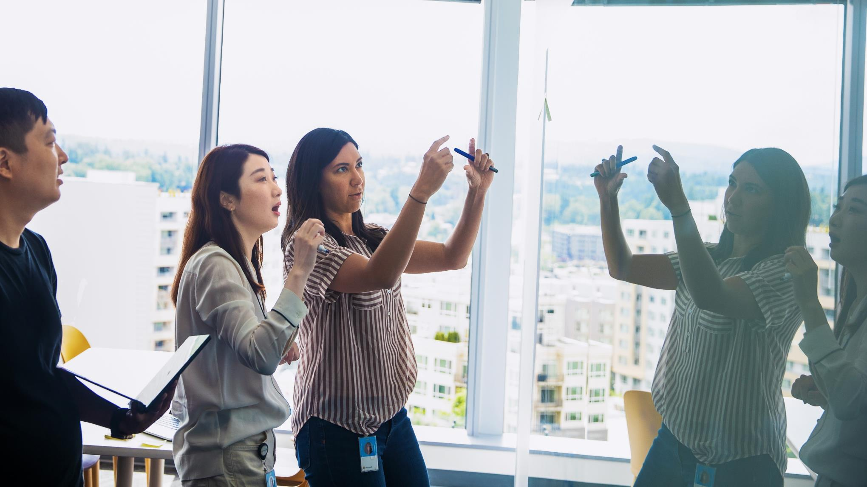
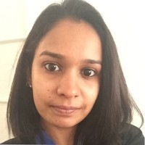
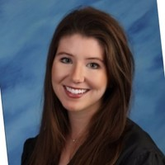


Agenda
Latest updates and news on the Microsoft 365 platform
Monthly community contributors
Group picture time with Together Mode!
Demos
Harini Saladi, Miceile Barrett and Mark Kashman - Fit and format Microsoft Lists for work and life
Sébastien Levert - Building Microsoft Graph Toolkit apps with SharePoint

Slide 3
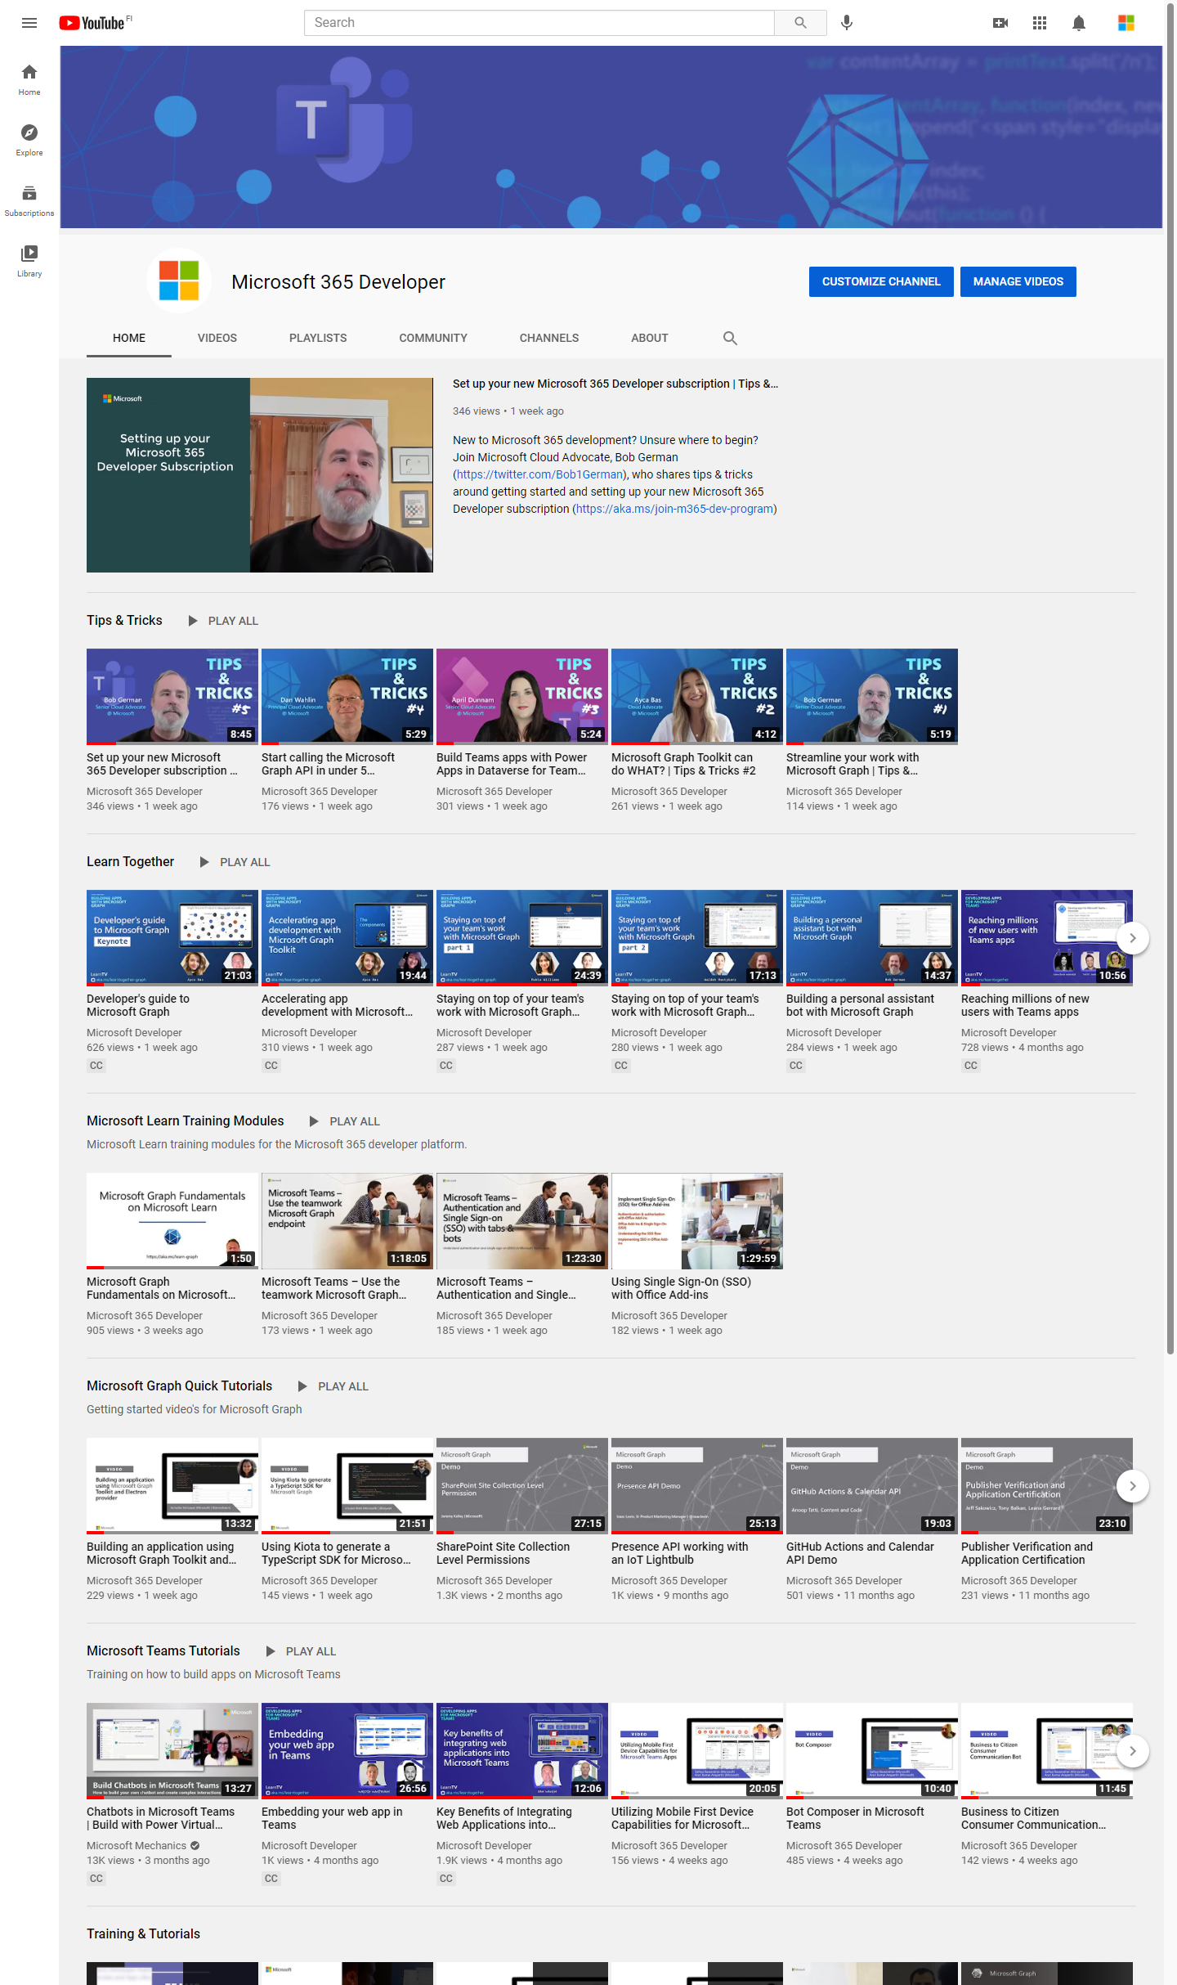
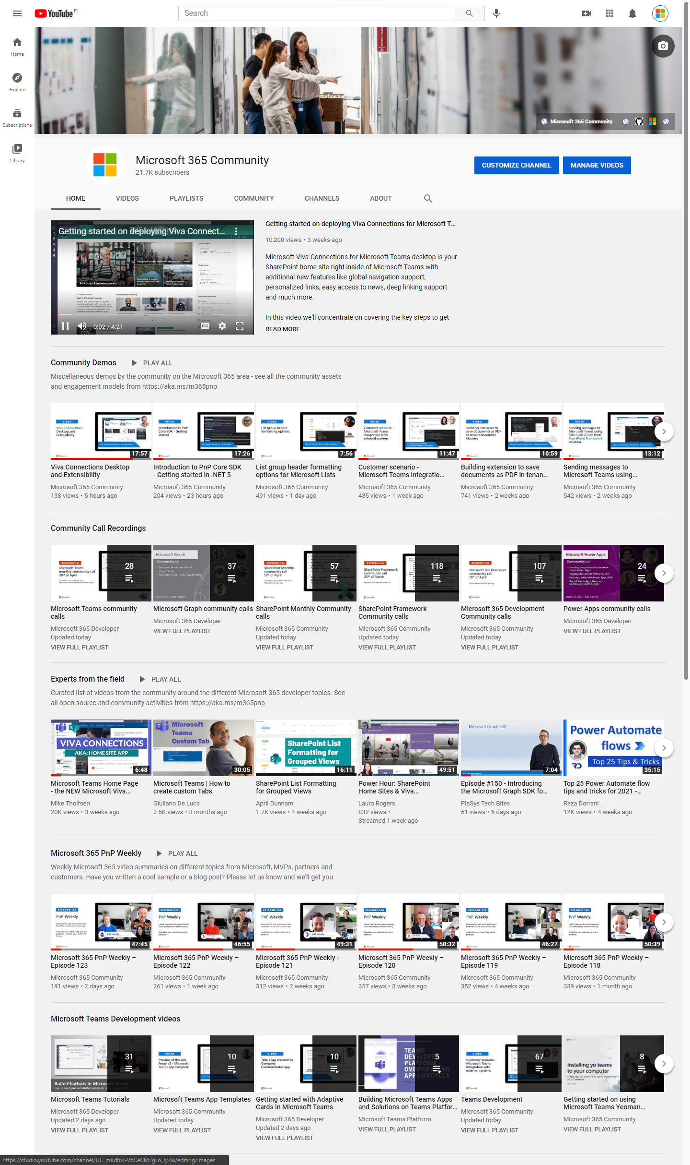
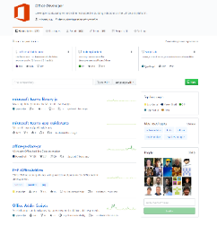
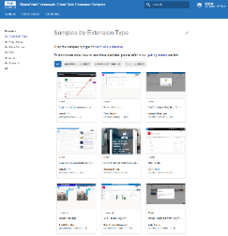
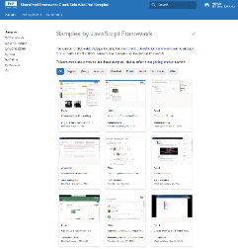
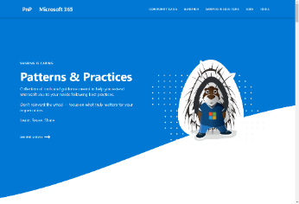
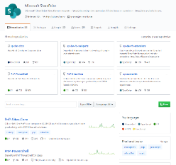
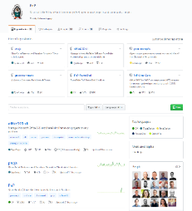
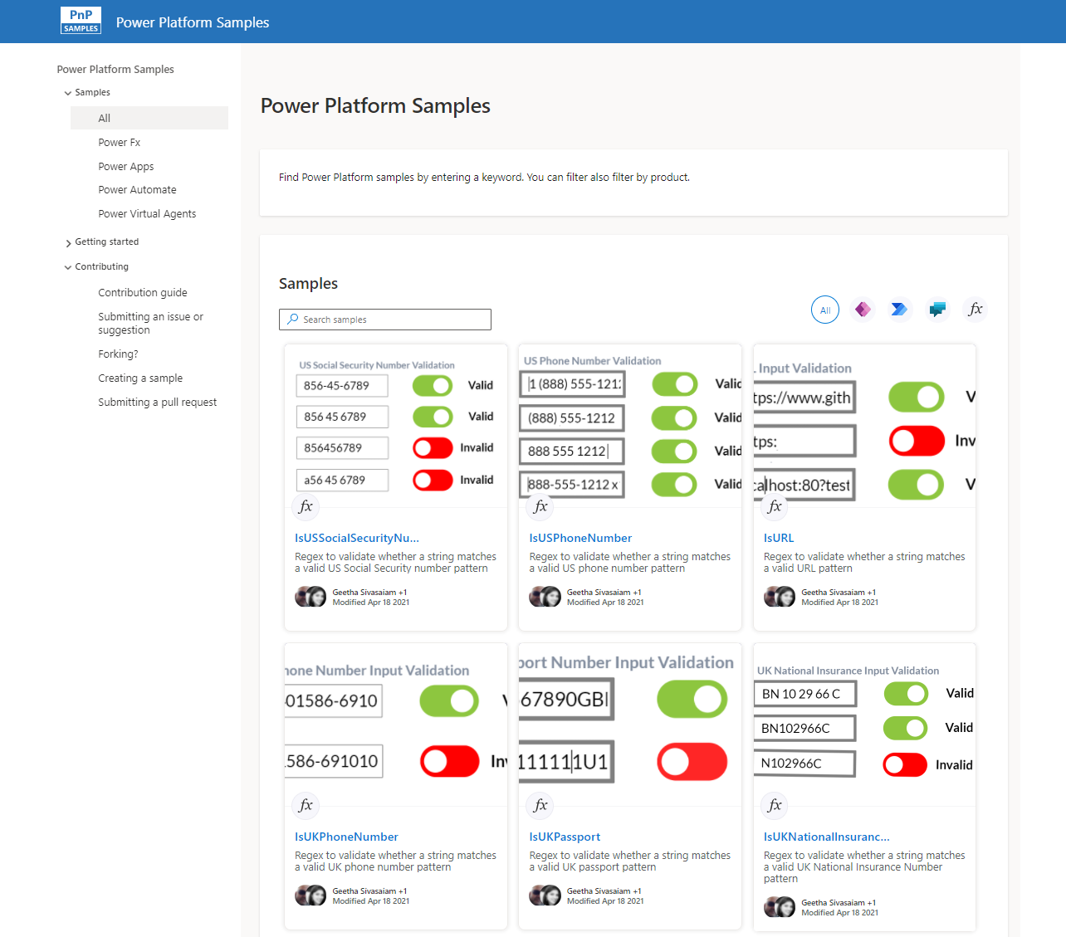
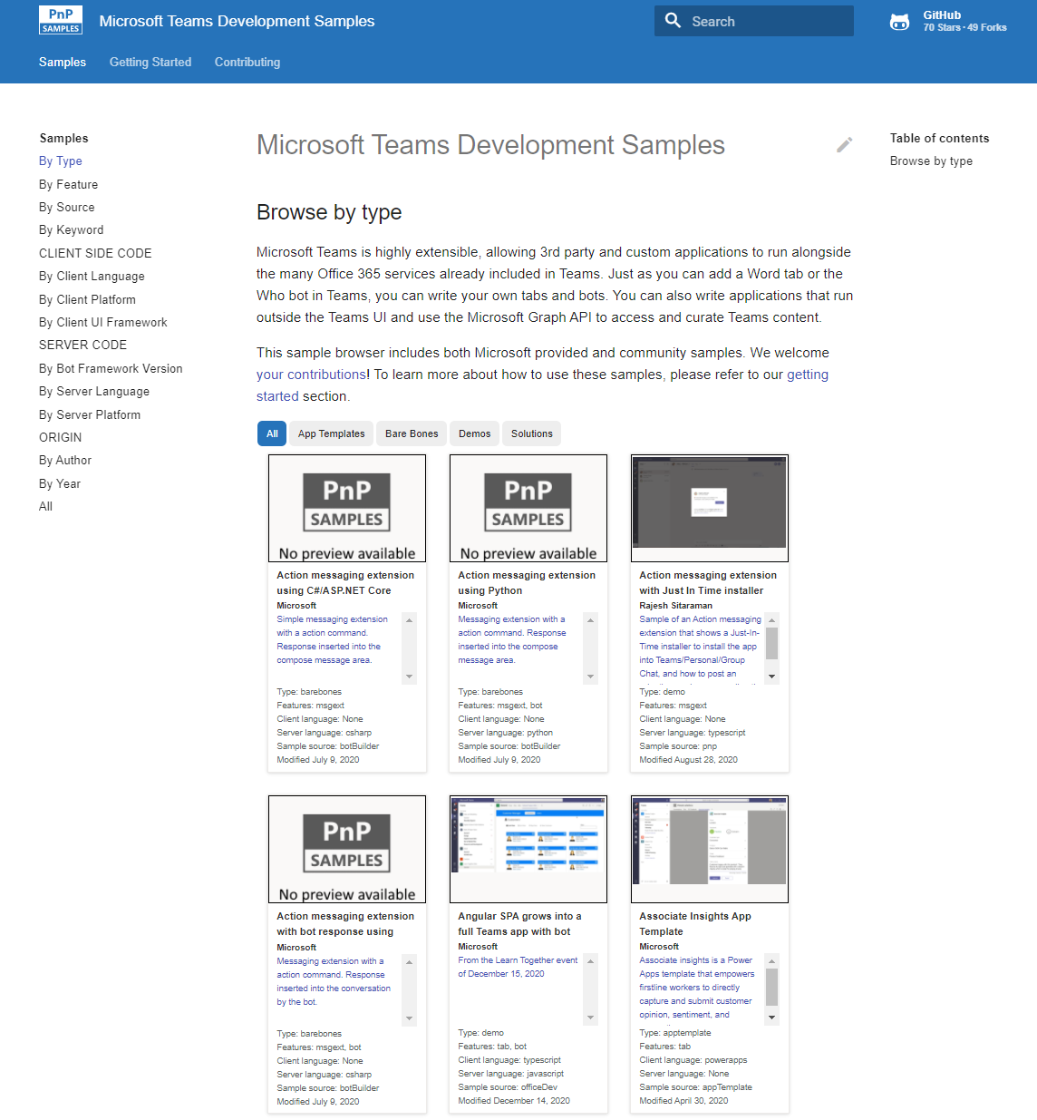
Microsoft 365 developer videos
Microsoft 365 community videos
Open-source
Sample galleries
Open-source initiatives and samples
aka.ms/m365devyoutube
aka.ms/m365/videos
github.com/pnp
github.com/officedev
github.com/sharepoint
github.com/microsoftgraph
aka.ms/teams-samples
aka.ms/spfx-webparts
aka.ms/powerplatform-samples
aka.ms/spfx-extensions
aka.ms/list-formatting
aka.ms/m365pnp
@Microsoft365Dev | @m365pnp

Slide 4

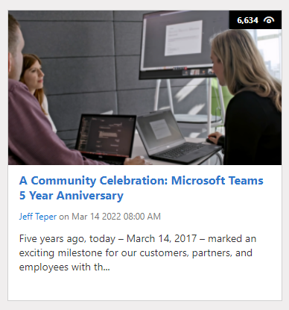
Congratulations for Microsoft Teams!
Microsoft Teams was released on 14th of March 2017.
Thank you for being part of this community!

Slide 5

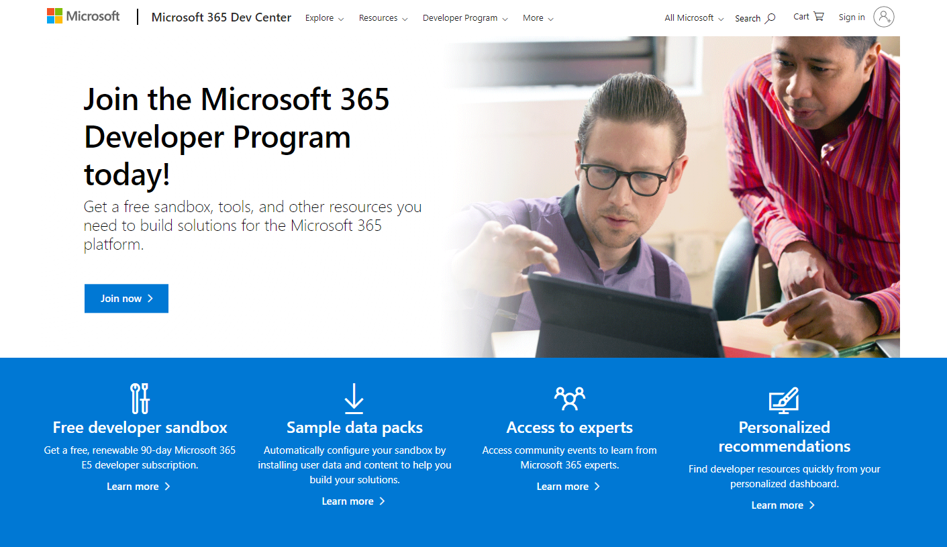

Now with instant availability!
GUIDANCE
Register to Microsoft 365 Developer Program for free E5 developer tenant and other assets
aka.ms/m365/devprogram

Slide 6
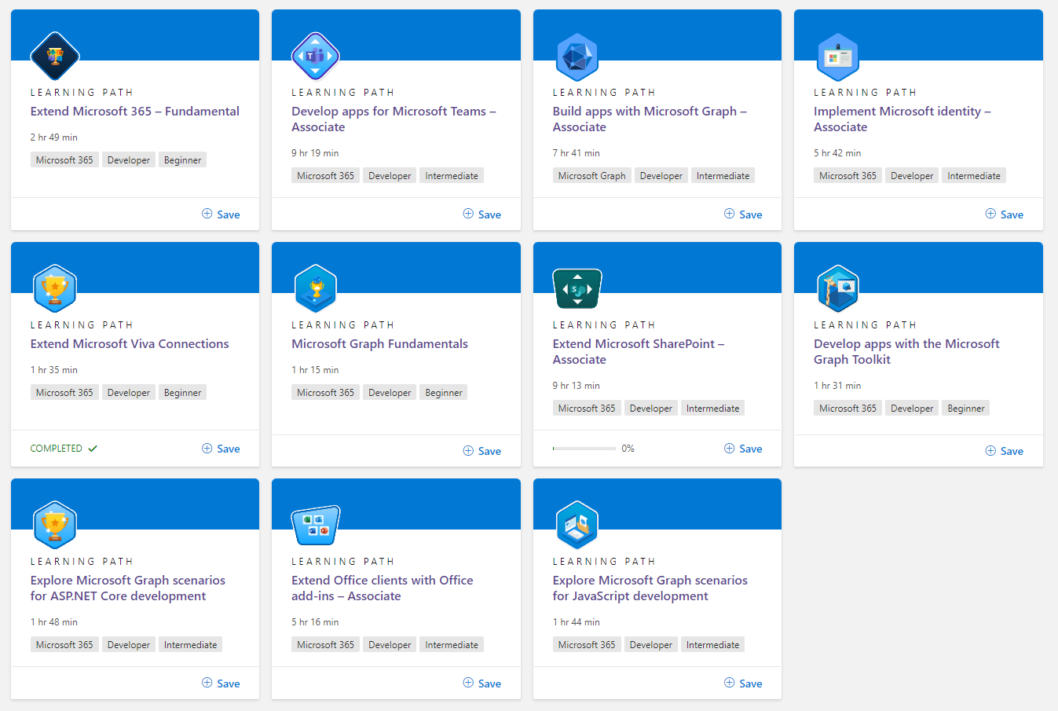
FREE!
LEARN
Get started on learning Microsoft 365 platform capabilities with these free training modules!
http://aka.ms/m365/dev/learn
Notes:
74 training modules – latest on building Microsoft Teams meeting apps

Slide 7


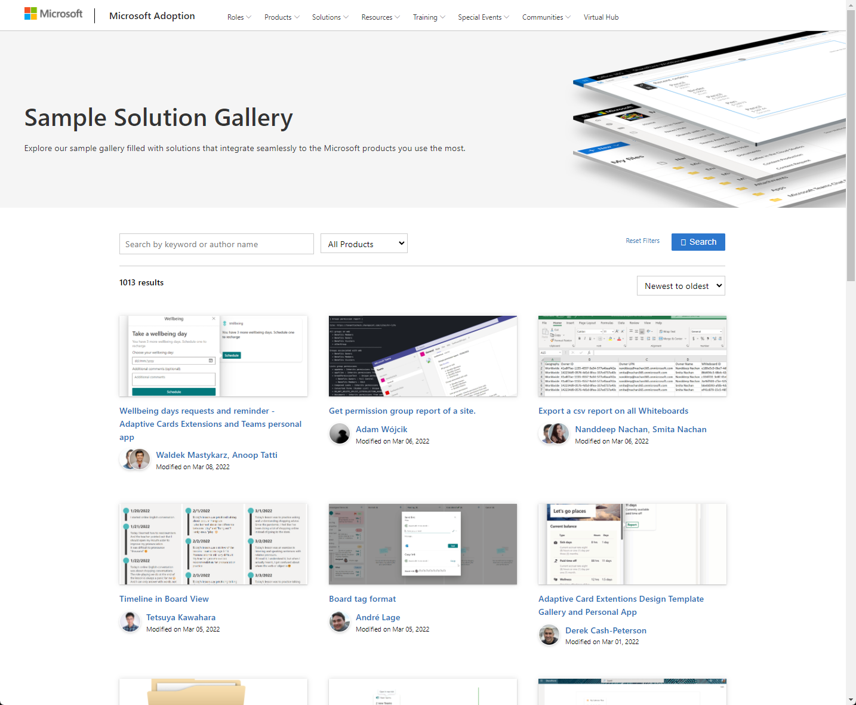
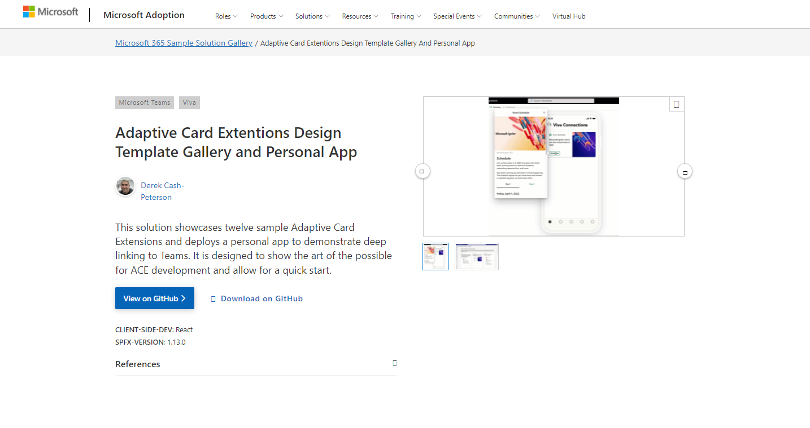

SAMPLES
New Microsoft 365 sample gallery with more than 500 samples from Microsoft and community
1000
aka.ms/m365/samples

Slide 8

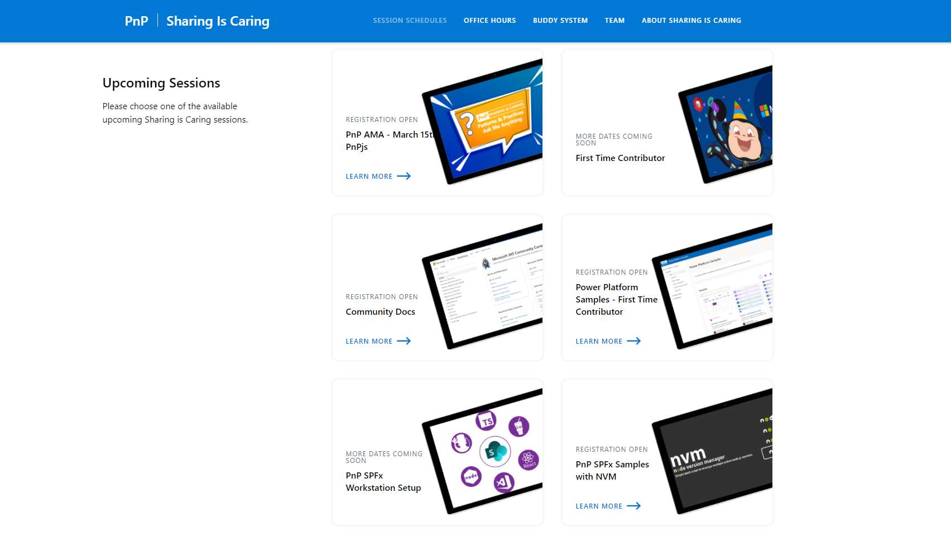
GUIDANCE
Learn how to get started in the open-source PnP community!
Upcoming Sessions:
General First Time Contributor
Power Platform Samples – First Time Contributor
Community Docs
SPFx Developer Workstation Setup
Using PnP SPFx samples w/ NVM
More than code with VS Code
First-time presenter
M365 Maturity Model Practitioners
Viva Connections ACEs (Coming Soon)
Ask me anything (PnPjs – March 15th)
Ask me anything (Viva Connections - Coming Soon)
TODAY!
https://aka.ms/sharing-is-caring
Notes:
25 Total attendees, 16 attendees who attended both First-Time Contributors and Community Docs sessions.

Slide 9

Microsoft 365 Developer Podcast
Weekly podcast concentrating fully to Microsoft 365 dev topics – hosted by Jeremy Thake (Microsoft) and Paul Schaeflein (Addin365)
m365devpodcast.com
Notes:
Monday 9th of February - Microsoft Graph Data Connect with Juan Balmori
Juan Balmori returns to the podcast, speaking with Jeremy about developing add-ins for Office Online.
Jeremy Thake and Paul Schaeflein

Slide 10
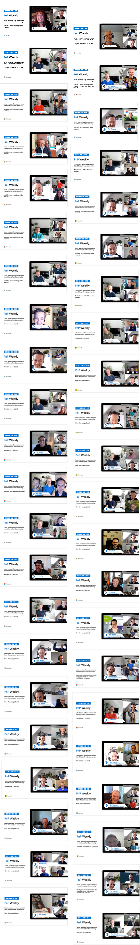
UPDATES
Microsoft 365
PnP Weekly
Latest news and announcements
from Microsoft and community.
Video – aka.ms/pnpweekly
Podcast – pnpweekly.podbean.com
#PnPWeekly
Notes:
Tuesday 15th of February – Visitor as Sudha Narayanan

Slide 11

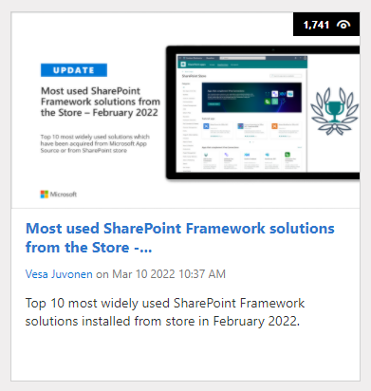
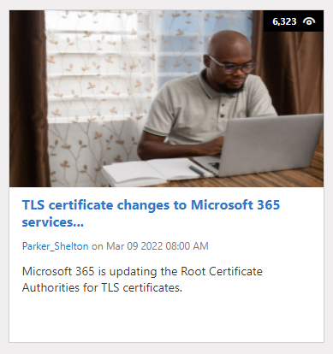
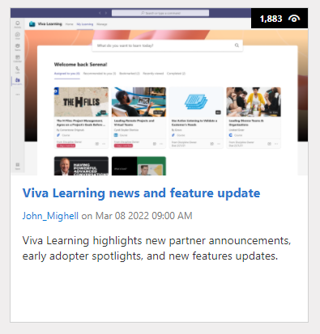
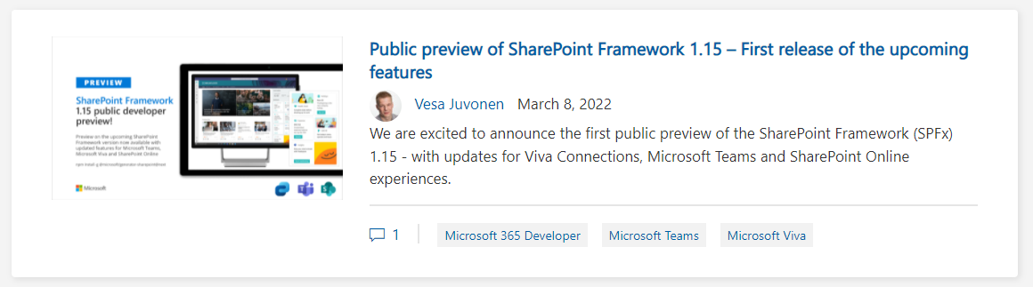
https://aka.ms/m365dev/blog
https://aka.ms/teams/blog
https://aka.ms/microsoftviva/blog

Slide 12




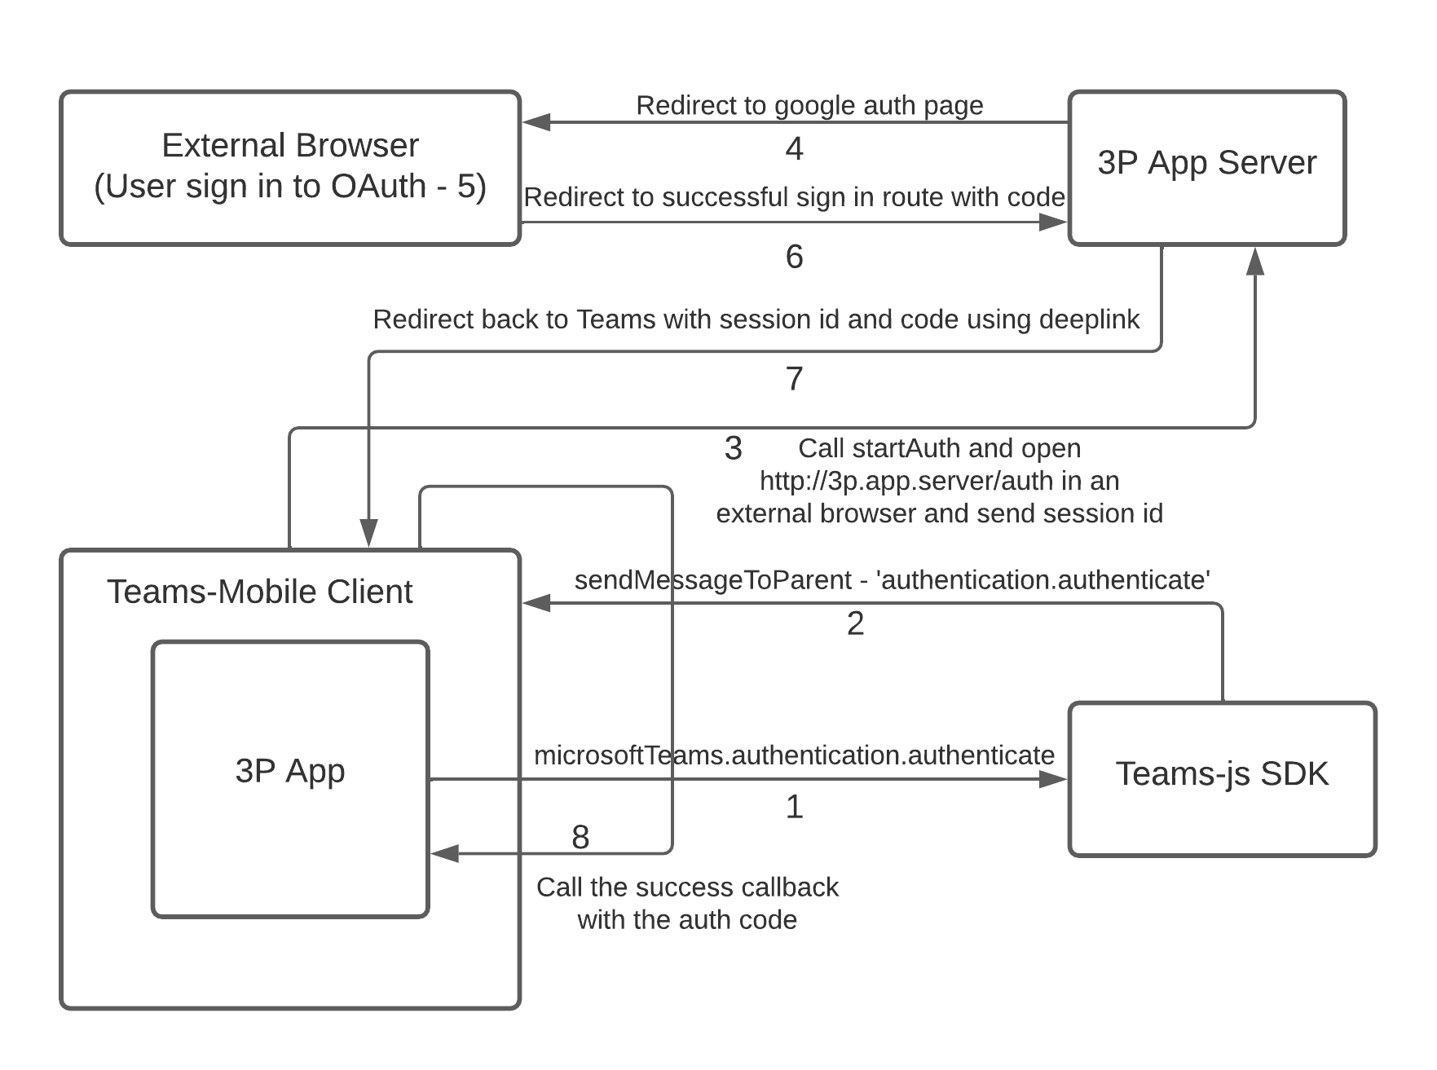
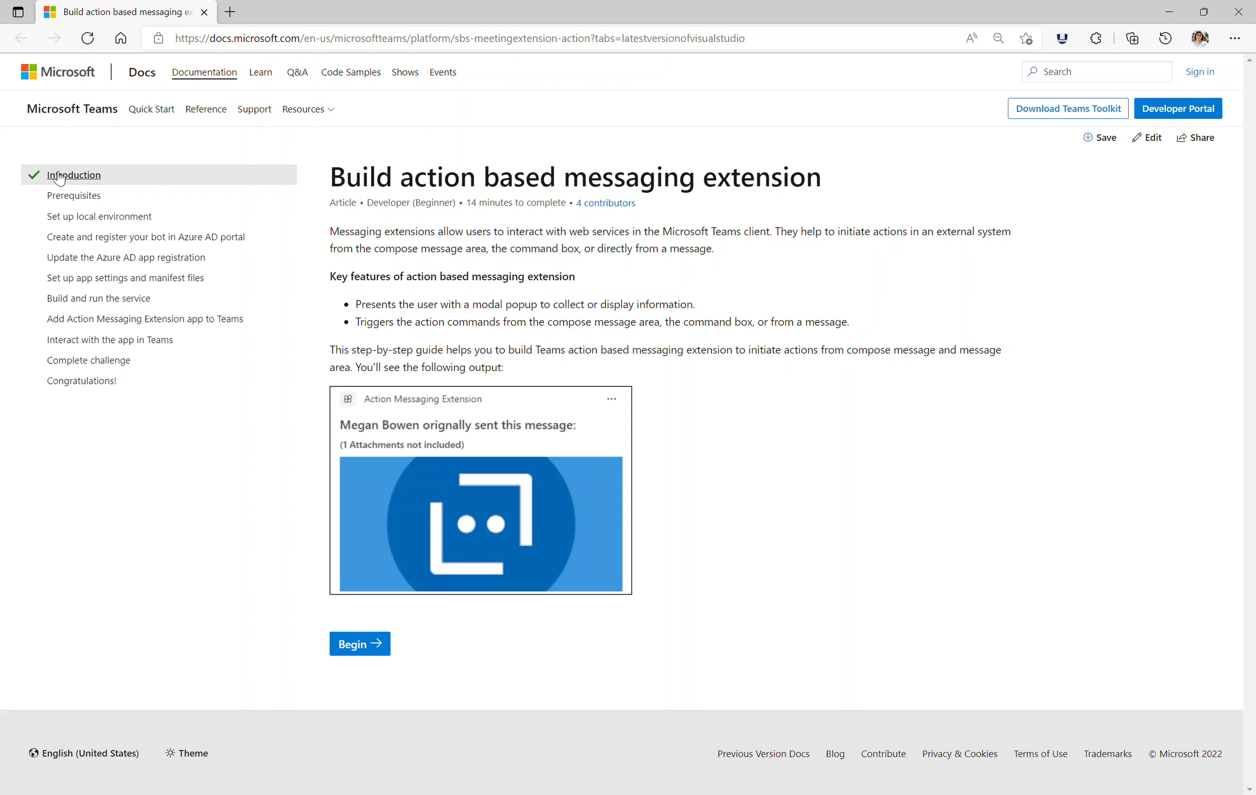






Teams Platform updates What’s new
Doc updates Step-by-step guides
Use external OAuth providers
Task oriented approach
Linear topics
End to end scenario
You can support external or third-party (3P) OAuth providers, such as Google, GitHub, LinkedIn, and Facebook using the updated authenticate() API: function authenticate(authenticateParameters?: AuthenticateParameters)
Docs: http://aka.ms/TeamsDevDocs > Microsoft Teams Developer Documentation > Step-by-step guides
1. Messaging extensions:
Build search-based messaging extension
Build action-based messaging extension
Docs: http://aka.ms/TeamsDevDocs > Add authentication > Tabs > Use external OAuth providers
2. Configure AAD SSO for tabs and messaging extension
3. Build Teams connectors
@Microsoft365Dev
aka.ms/TeamsPlatformUpdates
aka.ms/TeamsDevDocs
aka.ms/TeamsSamples
aka.ms/TeamsPlatformFeedback

Slide 13
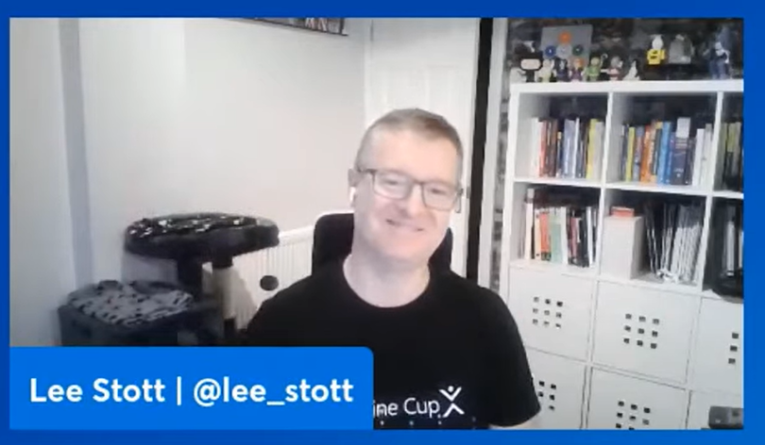
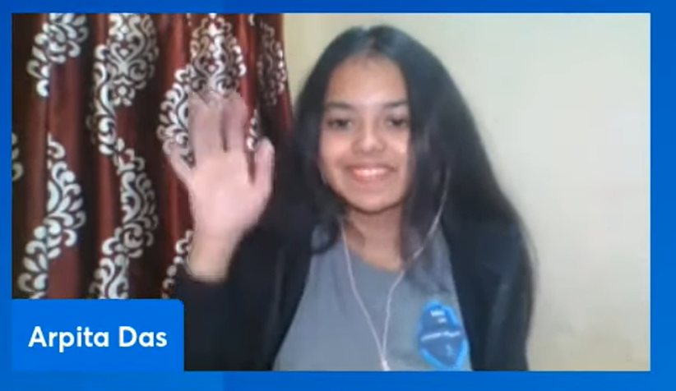
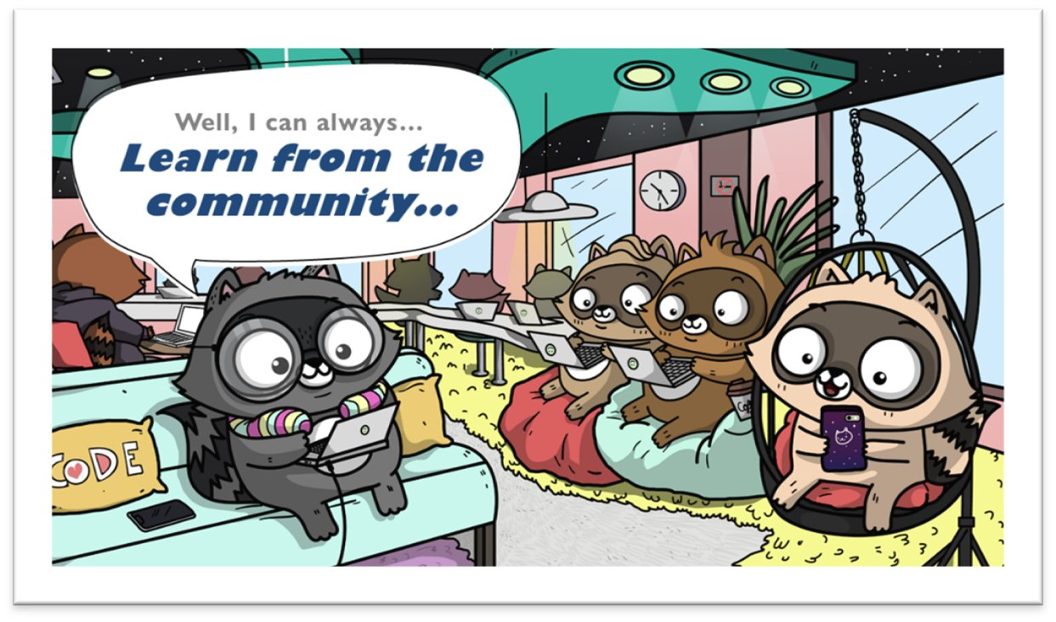
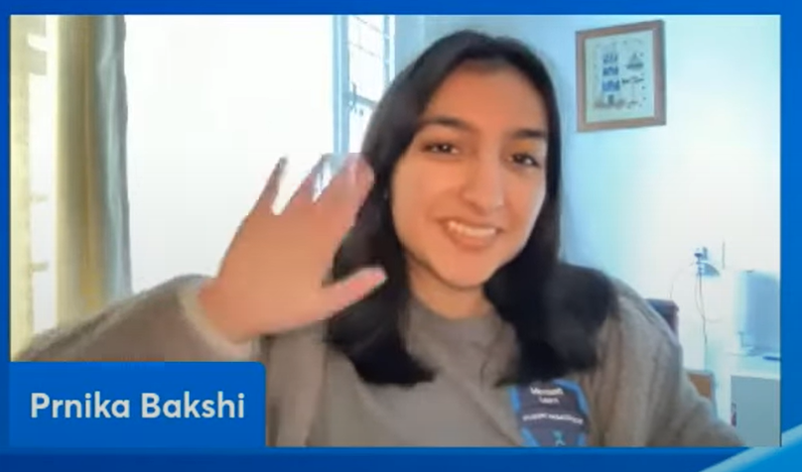
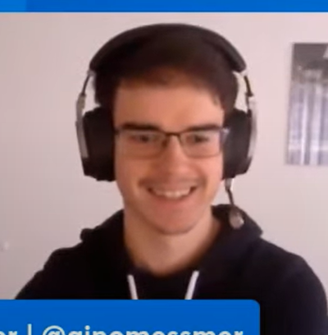
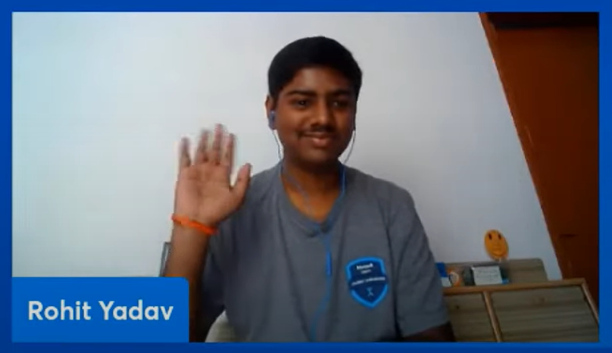

This week! Arpita Das, Gino Messmer, Prnika Bakshi, Rohit Yadav Power Virtual Agent bot that offers easy onboarding and verification process to users who want to join the communities on Microsoft Teams
https://aka.ms/LearnFromTheCommunity/ThisWeek
We want your stories in the series: aka.ms/share-your-story

Slide 14











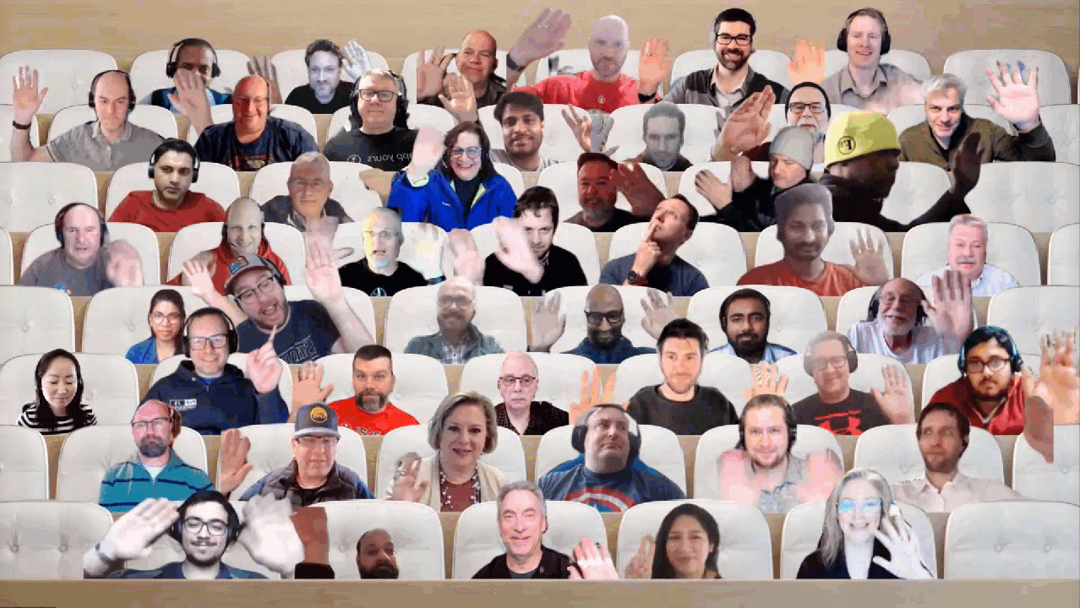

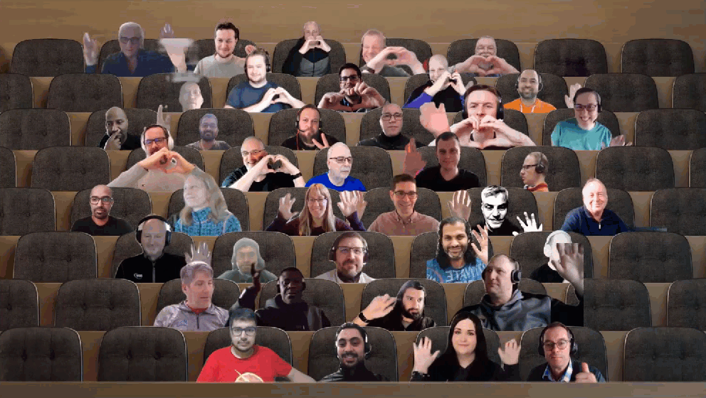







UPDATE
Microsoft 365 Platform Community (PnP) – March 2022 update is available! Thank you for your contributions!
http://aka.ms/m365pnp/community/blog

Slide 15

Thank you for your assistance within last month! (A-G)
Abderahman Moujahid (iThink365) | Abderahman88
Adam Wójcik (Hitachi Energy) | @Adam2585878
Ademosu Ayodele | aaademosu
Aimery Thomas | @aimery_thomas
Albert-Jan Schot (BLIS Digital) | @Appieschot
Alex Gonsales (Intergen) | MrDrSushi
Alexander Ernon (Amplexor)
Alexis CONIA (Kickle) | @Alexis_conia
Alienson | @Alienson
Alistair Pugin (Tangent Solutions) | @Alistairpugin
André Lage (Datalynx AG) | @aaclage
Andrea Mondello (Withum Smith + Brown) | @Mondello_power
Andrew Burns (AmSty) | @SharePointRox
Andrew Connell (Voitanos) | @Andrewconnell
Andrew Pilcher (CSULB) | andrewpilcher
Andy Harmon (Oldham Metropolitan Borough Council) | @Andygharmon
Anjaneyulu Yarlagadda | yarlagaddaanji
Annie Torres (Coppin State University)
Anoop Tatti (Content+Cloud) | @Anooptells
Antti Pajunen (Forward Forever) | @Anttipajunen
Aric Bost (North Carolina Housing Finance Agency) | @1CyberState
Arjun Menon (Tata Consulting Services) | @Arjunumenon
Arleta Wanat | PowershellScripts
Art Pagano (University of Texas San Antonio)
Artur Posluszny | aposl1
Asad Refai (Intelogy) | @AsadRefai
Ashwani Kumar (Walmart Global Tech) | @Ashwanidv100
Bartolomeo Sorrentino (soulsoftware) | @BsorrentinoJ
Beau Cameron (Aerie Consulting) | @Beau__Cameron
Bob Morris (ThreeWill)
Carianne Wong (Majesco) | @CW_marie
Carike Blignaut-Staden | @CarikeBStaden
Carmen Ysewijn (Qubix) | @Carmenysewijn
Catherine Thenault (AIPSO) | @O365techcat
Chanaka Palliyaguru (Fortude) | @Chanakavp
Chandani Prajapati (Rapid Circle) | @Chandani_SPD
Chandra Sekhar Malla (Royal Group LLC) | @ChandraSMall
Chris Kent (DMI) | @TheChrisKent
Chris Sparrow (PA Consulting)
Christian Zuellig (MondayCoffee) | czullu
Christophe Humbert | @Path2SharePoint
Christopher Graves (Arvato) | @Christo48927551
Chuck Piotrowski (PIOT) | @chuckpiot
Clavin Fernandes (Rapid Circle) | @Clavinfernandes
Clement Olivier | @Clement0livier
Cynthia Tiwana (city of sammamish) | ctiwana
Damien Bird | @DamoBird365
Daniel Laskewitz (Sogeti) | @Laskewitz
Daniel Westerdale (Westerdale Solutions Ltd) | @Westerdaled
Danish Shafi | @Builtbydan
Darren Brown (Node4)
Dave Young | @Klarkykhat
David Gray (Visa)
David Pileggi (Staples) | DavidPileggi
David Ramalho | @DRamalho92
David Warner II (Catapult) | @DavidWarnerII
Dean Gross (Insight) | @Dean144
Dennis Goedegebuure (Ultima Business Solutions) | Expiscornovus
Derek Cash Peterson (Sympraxis Consulting) | @Spdcp
Dipen Shah (Rapid Circle) | @Dips_365
Don Kirkham (DMI, Inc) | @DonKirkham
Dr Adrian Colquhoun (Strategik) | iddycol
Edmund David (Insentra)
Edris Kakembo (WFP) | @Kaxeddie
Eduardo Cáceres | eduherminio
Ejaz Hussain (Content and Cloud) | @EjazHussain"
Elio Struyf (Struyf Consulting) | @Eliostruyf
Elise Yang (Shopify) | elisenyang
Elka Dunnette | @ElkaD_YYC
Emily Mancini (Sympraxis Consulting) | @EEMancini
Eric Overfield (PixelMill) | @EricOverfield
Erwin van Hunen (Valo Intranet) | @Erwinvanhunen
Florian Zink | fzbm
Franck Cornu | @FranckCornu
Ganesh R (RapidCircle) | @Geekwhocodes
Ganesh Sanap (Globant) | @GaneshSanap20
Garrick George (City of Thornton) | @Kod3m0ng3r
Notes:
SHARING KNOWLEDGE IS MULTIPLYING KNOWLEDGE

Slide 16
Thank you for your assistance within last month! (G-N)
Gaurav Mahajan | @Mahajang
Gautam Sheth (Valo Solutions) | @Gautamdsheth
Geetha Sivasailam (Artis Consulting) | @GSiVed
Giacomo Pozzoni (Fellowmind) | jackpoz
Giuliano De Luca | @delucagiulian
Haritha Sama (Intouch Solutions)
Harry Jones (Civica) | @Hejones50
Harsh S (SRK Consulting)
Harsh Samdani | hsamdani12
Harshini Varma (Capgemini) | @HarshiniVarmaa
HEMANT RISBUD (SRK Consultants) | Hemant Risbud
Henrik Yllemo (Ylltec Sweden AB) | @Yllemo
Inez Jacobs (Amplexor)
Isolde Kanikani (SoftwareONE)
Jacob Warrington (Catapult Systems) | @Jjhwarrington
Jan Bakker | @JanBacker_
Jasey Waegebaert (MI group) | Jwaegebaert
Javier Hualpa | jhualpa
Jeffin Jacob | jeffinjacob
Jennifer Davison (Akron Children's Hospital)
Jennifer Erzen (SUNY Upstate Medical University) | @Jennifererzen
Jerker Vallbo | jerval53
Jhan Zaib (Ascertia) | jhan-zaib
Jim Duncan (ShareSquared) | @Sparchitect
Jinlong Wang | apzl808
Jiten Parmar (Rapid Circle) | @Jitenpa44241205
João Ferreira | @Joaoferreira
João J. Mendes (Valo Solutions) | @Joaojmendes
Joel Rodrigues (Storm Technology) | @JoelFMRodrigues
Jonas Björkander (Heimstaden) | @Jonasbjor
Jonathan Hinchliffe (Imperial War Museums)
Jonathan Weaver (WaterOne) | @J_weaver74
Jono Duncan (JourneyTEAM) | @SuaveJono
Julie Turner (Sympraxis Consulting) | @Jfj1997
Kasper Bo Larsen (Fellowmind) | @Kasperbolarsen
Kathleen Boilek (Alaka'ina Foundation) | @Kaboilek
Katleen Van Trier (Inetum-Realdolmen) | @Kvantrier
Katrin Rannaste
Kevin McDonnell (CPS) | @Kevmcdonk
Kim Kiefer (GenTech Associates) | @Kkkiefe
Kunj Balkrishna Sangani | @Sanganikunj
Kyle Bigelow | hazondata
Lance Yoder (Cerner) | @Lyoder
Laura Kokkarinen (Sulava) | @LauraKokkarinen
Laurent Egbakou | @Lioncoding
Lee Ford ( Symity) | @Lee_Ford
Leon Armston (Intelogy) | @LeonArmston
Lindsay Shelton (Stowers Institute for Medical Research) | @Lshelton_tech
Loïc Cimon (Sogeti) | @LoicCimon
Luise Freese (M365Princess) | @LuiseFreese
Manickam Sethuramalingam (microland)
Manjunath Puttaswamy (Momentive Performance Materials India Private Limited) | @ManjunathPutta3
Marc Anderson (Sympraxis Consulting) | @Sympmarc
Markus Möller (Avanade) | @Moeller2_0
Martin Lingstuyl | @Martinlingstuy
Matt Beard (Data8) | @Mattybeard
Matt Collins-Jones | @D365Geek
Michael Blumenthal (M365chicago.com) | @MichaelBL
Michael Roth ( ITP) | @MichaelRoth42
Michal Guzowski (Developico) | @Abcguzowski
Michal Romiszewski | @Romiszewski
Michal Ziemba (Flugger) | @Michal_Ziemba
Michel Mendes | @Michelcarlo
Michelle Heisler (Hennepin County)
Miguel Angel García | @Miangama
Mike Duffy (Boardwalk Pipelines) | @Mike_duffy
Mike Dumka (Habanero Consulting) | @Mikedumka
Mike Zimm | mikezimm
Mohammad Amer (Atea Global Services) | @Mohammad3mer
Nanddeep Nachan | @nanddeepNachan
Naveen Karla | @naveen67
Nicole Fleming (Sherwin Williams)
Nikki Chapple (Cloudway) | @Chapplenikki
Nizar Grindi (Avanade) | @nizar_grindi
Norm Young (UnlimitedViz) | @Stormin_30
Notes:
SHARING KNOWLEDGE IS MULTIPLYING KNOWLEDGE

Slide 17
Thank you for your assistance within last month! (N-Y)
Omar Stewart | @OmarStewey
Paolo Pialorsi (PiaSys.com) | @PaoloPia
Patrick de Lanoy(EmpowerTech) | @EmpowerPatrick
Patrick Doran (NCDIT) | @Swearpointjs
Patrick Galloway | BammaSlim
Patrick Lamber (ExpertsInside AG) | @Patricklamber
Patrik Hellgren (Sherpas Group) | @Patrikhellgren
Paul Bullock (CPS) | @Pkbullock
Paul Culmsee (Seven Sigma) | @Paulculmsee
Paul McManus | @PaulMcManus23
Paul Schaeflein (AddIn365) | @Paulschaeflein
Pedro Monte (BindTuning) | PedroMordeP
Pete Simpkins (Fluid Interiors) | @Simpkinspete
Pete Skelly (ThreeWill ) | @Pskelly
Phil McNiven | phil0074
Pierre Geraud (Bluekango) | pedrion
Prafull Kotecha | @Prafull
Ralph Rivas (Sogeti) | @Bigpix2000
Rentu | SLdragon
Reshmee Auckloo (Pension Protection Fund) | @ReshmeeAuckloo
Rick Van Rousselt (Advantive) | @RickVanRousselt
r-markus | r-markus
Rob Bell (Kizan technologies)
Rob Ireland (Oast House Ltd) | @RobIreland68
Robert Copelan (ZF Friedrichshafen AG) | @Rcopelan
Robert Dyjas (EQTek) | @Robdy
Rodrigo Pinto (Storm Technology) | @ScoutmanPt
Rohit S Patil (C3it)
Russell Gove (tronox) | @Russgove
Ruth Shyer (SuMMit Consulting, LLC) | @Rshyer
Ryan Healy (365Apps) | @Ryan365Apps
Sabrina Faragoza (Cognizant's Microsoft Business Group)
Sachchin Annam (Freelancer) | @Sachchinn
Sam Bridegroom (Allied Solutions) | @Sambridegroom
Sekar Thangavel (IBM) | SekarThangavel
Sergei Sergeev | @Sergeev_srg
Sharon Weaver (Smarter Consulting) | @Sharoneweaver
Shishir | skky05
Shrushti Shah (Rapid Circle)
Siddharth Vaghasia | @Siddh_me
Simon Ågren | @AgrenPoint
Simon Doy (iThink 365) | @Simondoy
Simon Hudson (Novia Works) | @Simonjhudson
Smita Nachan | @SmitaNachan
Someleze Diko | DikoSomeleze
Sorina Becheru (abtis GmbH)
Soumit Mukherjee | @Msoumit
Soumyadeep Mukherjee | soumyadeep2207
Sourav Paul | @Spsouravp
Stefan Bauer (n8d) | @StfBauer
Stephan Bisser (Solvion) | @Stephanbisser
Steven Reid (FTZ) | @Steven_reid
Sujith Pasupuleti (NRF) | @Sujith1907
Sumit Jadon (Avanade) | @CoolJadon
Sunish (SACHA Solutions) | @Sunish
Takashi Shinohara | @Karamem0
Tammy Dupuy (CSULB)
Tetsuya Kawahara | @Techan_k
Thomas Gölles (Solvion) | @Thomyg
Tim Balk (Wellmark) | @Tlbalk
Tim Cadenbach (Maximago) | @TimCadenbach
Tod Beane
Todd Alexander (Island Way Technology)
Todd Baginski (Canviz) | @Toddbaginski
Tom Morgan (Modality Systems) | @tomorgan
Tomasz Poszytek | @TomaszPoszytek
Tony Derricott (BYUI) | @Computx
Troy Taylor (Hitachi Solutions) | @Troystaylor
Twan van Beers (Nero Blanco) | @neroBlancoIT
Vardhaman Deshpande (Valo Solutions) | @vrdmn
Veronique Lengelle (CPS) | @Veronicageek
Victor Ezeliorah (Intels Nigeria Limited) | @Vezeliora
Vipul Kelkar (Rapid Circle) | @Vipulkelkar
Vivek Bavishi | @That_API_guy
wuxiaojun514 | wuxiaojun514
Yannick Plenevaux (PVX Solutions) | @Yp_code
Youssef Moumen
Yves Habersaat (Sword Group) | @Yhabersaat
Zach Roberts | @ZachSPODev
Notes:
SHARING KNOWLEDGE IS MULTIPLYING KNOWLEDGE

Slide 18































Companies involved with March 2022 summary
Companies which provided support for community
We can only show the company logos which we have explicitly approval for logo usage
You contributed and your company is not here? – Send us a message with your permissions and logo
Notes:
SHARING KNOWLEDGE IS MULTIPLYING KNOWLEDGE

Slide 19

Thank you for your assistance! – Microsoft
Aakash Bhardwaj (Microsoft) | @Aakash_316
Abid Rahman (Microsoft)
Alex Clark (Microsoft) | @Sharepointalex
Alex Terentiev (Microsoft) | @Alexaterentiev
Aline Tognini (Microsoft) | alinefmr
Allen Snow (Microsoft) | @Asnow003
Altamish Ahmad (Microsoft)
Andrey Esipov (Microsoft)
April Dunnam (Microsoft) | @Aprildunnam
Arijit Mondal (Microsoft)
Arvind Ravi (Microsoft)
Ashima Mathur (Microsoft)
Ayca Bas (Microsoft) | @Aycabs
Bert Jansen (Microsoft) | @O365Bert
Beverly Kim (Microsoft) | bvandaal
Bob German (Microsoft) | @Bob1German
Brian Dang (Microsoft) | @Mrdang
Brian Jackett (Microsoft) | BrianTJackett
Bryan Petersen (Microsoft) | bpeterse03
Cathy Dew (Microsoft) | @Catpaint
Charles Sterling (Microsoft) | @Chass
Christer Ljung (Microsoft)
Christos Matskas (Microsoft) | @ChristosMatska
Dan Wahlin (Microsoft) | @DanWahlin
Dave Randall (Microsoft) | triplanedave
David Chesnut (Microsoft) | @Davidchesnut
Doğan Erişen (Microsoft) | derisen
Dragan Panjkov (Microsoft) | @Panjkov
Ed Averett (Microsoft) | Ed_Everett
Emily Lynam (Microsoft)
Elizabeth Samuel (Microsoft)
Emma Cooper (Microsoft)
Garry Trinder (Microsoft) | @Garrytrinder
Haimantika Mitra (Microsoft) | @HaimantikaM>
Holger Lutz (Microsoft) | HolgerLutz
Hugo Bernier (Microsoft) | @Bernierh
Igor Ribeiro (Microsoft)
James Eccles (Microsoft) jameseccles
James Skay (Microsoft) | @JamesSka
Japhlet Nwamu (Microsoft) | @Japhletnwamu
Jasey Waegebaert (Microsoft) | Jwaegebaert
Jasmine Hoegh (Microsoft) | @Sbjishu
Jason Johnston (Microsoft) | jasonjoh
Jay Hangan (Microsoft)
John Nguyen (Microsoft) | johnguy0
John Sudds (Microsoft) | @Jsuddsjr
Jos Verlinde (Microsoft) Josverl
Jyoti Pal (Microsoft)
Kavishi Agarwal (Microsoft)
Kevin Coughlin (Microsoft) | @Kevintcoughlin
Keyur Patelsdata (Microsoft)
Koen Zomers (Microsoft) | @Koenzomers
Holland Kaviani (Microsoft)
Laura Graham (Microsoft) | Lauragra
Holland Kaviani (Microsoft)
Lee Stott (Microsoft) | @Lee_Stott
[Linda Delarvé (Microsoft)
Linda Lu Cannon - (Microsoft) | lindalu-MSFT
Loki Meyburg (Microsoft) (Microsoft) | @Lokimeyburg
Luca Bandinelli (Microsoft) | lucaband
Mansa MusaLe (Microsoft) | @M4musale
Mathangi Chakrapani (Microsoft)
Matthijs Hoekstra (Microsoft) | @Mahoekst
Max Kulakov (Microsoft)
Michael Aldridge (Microsoft)
Mikael Svenson(Microsoft) | @Mikaelsvenson
Mike Hollinshead (Microsoft) | @Mahollinshea
Nancy Wang (Microsoft) | @nancyatMSFT
Natalie Pienkowska (Microsoft) | @nataliePienkow1
Nathan Zipf (Microsoft) | NathZ1
Nick Adman (Microsoft)
Nick Kramer (Microsoft)
Nik Charlebois (Microsoft) | @nikCharlebois
Nicolas Vogt (Microsoft) | vogtn
Nikolay Zainchkovskiy (Microsoft) | NZainchkovskiy
Nickii Miaro (Microsoft) | Nickii Miaro
Niko (Microsoft) | NikoMix
Nikola Metulev (Microsoft) | @Metulev
Orion O'Malley (Microsoft)
Pam Green (Microsoft) | @Contextuallib
Parag Jain (Microsoft)
Pat Miller (Microsoft) | @PatMill_MSFT
Patrick Rodgers (Microsoft) | @Mediocrebowler
Rabia Williams (Microsoft) | @Williamsrabia
Rajdeep Chandra
Ravichandran Krishnasamy (Microsoft) | @Spfx_blog
Richard Astbury (Microsoft) | @Richorama
Rick Kirkham (Microsoft)
Roel (Microsoft) | RoelVB
Roy Paar(Microsoft)
Rui Santos (Microsoft)
Sam Larson (Microsoft) | salarson
Shane Weaver (Microsoft) | shweaver-MSFT
Shreyansh Agrawal (Microsoft) | shagra-ms
Sébastien Levert (Microsoft) | @Sebastienlevert
Srinivas Varukala (Microsoft) | @Svarukala
Steven Jia (Microsoft) | Steven-Jia
Shubham Gatkal (Microsoft)
Tejas Mehta (Microsoft) | @Tpmehta
Tim Mayo (Microsoft) | @Timmayo
Tom Resing (Microsoft) | @Resing
Tomomi Imura (Microsoft) | @Girlie_mac
Vesa Juvonen (Microsoft) | @Vesajuvonen
Wajeed Shaikh | Wajeed-msft
Waldek Mastykarz (Microsoft) | @Waldekm
Wictor Wilen(Microsoft) | @Wictor
Vincent Biret (Microsoft) | @baywet
Zakiullah Khan (Microsoft)
Notes:
SHARING KNOWLEDGE IS MULTIPLYING KNOWLEDGE

Slide 20
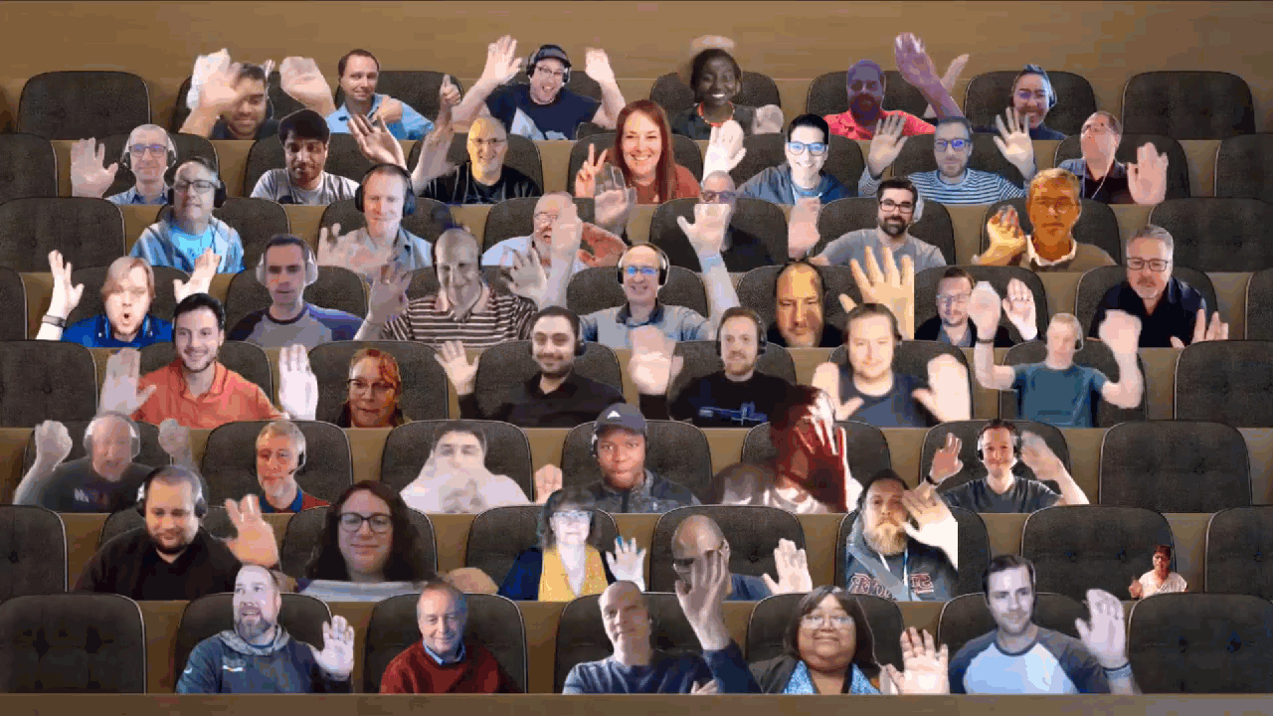

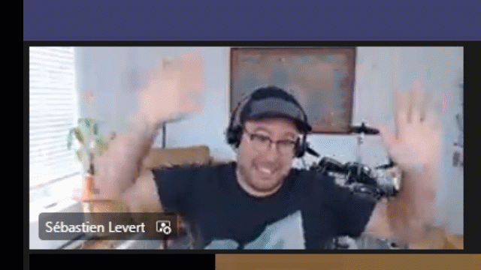
Optional picture time!
Video on and we’ll grab a Together Mode pic with those who are willing to do this.
We are together on this as a community!
Let’s all be like Seb
By enabling your camera for the picture, you grant us permission to share your picture in social media.

Slide 21

DEMO
Fit and format Microsoft Lists for work and life
- Harini Saladi
- Miceile Barrett -
- Mark Kashman
Building Microsoft Graph Toolkit apps with SharePoint
- Sébastien Levert

Slide 22
Microsoft 365 developer community calls
Microsoft 365 platform call (weekly) https://aka.ms/m365-dev-call
Adaptive Cards (monthly) https://aka.ms/adaptivecardscommunitycall
Microsoft identity platform (monthly) https://aka.ms/IDDevCommunityCalendar
Office Add-ins (monthly) https://aka.ms/officeaddinscommunitycall
PowerApps (monthly) https://aka.ms/PowerAppsMonthlyCall
Microsoft 365 Community (bi-weekly) https://aka.ms/m365-dev-sig
Viva Connections and SPFx (bi-weekly) https://aka.ms/spdev-spfx-call
All calls and assets: https://aka.ms/m365pnp
Notes:
m365-dev-sig

Slide 23
Thank you
Recording will be available in 24 hours on
Microsoft 365 Community (PnP) YouTube channel
https://aka.ms/M365PnP/videos
(subscribe today)
Follow us on Twitter
@Microsoft365Dev | @M365PnP
Next Microsoft 365 Platform call: March 22nd at 08:00 am PT
All available community calls from https://aka.ms/m365pnp

Slide 24



aka.ms/m365pnp

